Slide 1

AgriGuardian AI: An SOA-Based Agentic Framework for Carbon-Aware Autonomous Irrigation in Paddy Cultivation
SOA Project Review-3
September 16th, 2026
 | Under the Guidance of Dr. Srikanth Cherukuvada Assistant Professor, Department of Computer Science and Engineering, KLH CSE Bowrampet Campus
Team Members V.Varshita – 2420030230 M.Vaishnavi – 2420030665 Vokitha.T - 2420030462

Slide 2
Outline of Research Work
Focus
Introduction
Literature Survey
Challenges
Research Objectives
Conclusion & Future Work
References
Publications Details

Slide 3
Problem Statement
Paddy cultivation often relies on manual or fixed-schedule irrigation, which can lead to water wastage, unnecessary energy consumption, and increased carbon emissions.
Existing smart irrigation systems mainly focus on soil moisture and do not fully consider weather conditions, crop requirements, energy use, and carbon impact together.
AgriGuardian AI aims to address this problem by developing an SOA-based agentic framework that autonomously analyzes multiple factors, selects the most sustainable irrigation time, and makes explainable irrigation decisions while minimizing water, energy, and carbon impact.

Slide 4
Innovation, Creativity, and Novelty
🔹 Innovation:
The system does not simply decide whether to irrigate; it determines the most suitable time to irrigate.
It considers soil moisture, crop water requirement, weather forecast, energy consumption, and carbon impact before selecting an irrigation window.
🔹 Creativity:
Generate multiple possible irrigation windows, such as Now, +2 Hours, +4 Hours.
Calculate a Sustainability Score for each window based on water, energy, weather, and carbon factors.
🔹 Novelty:
The key novelty is a carbon-aware irrigation scheduling mechanism that autonomously selects the most sustainable irrigation window instead of using fixed schedules or simple soil-moisture thresholds.

Slide 5
Feasibility
1. Technical Feasibility:
IoT sensors can collect soil moisture, temperature, humidity and water-level data.
AI/ML models can predict irrigation requirements.
AI agents can analyze soil, weather, crop and carbon factors.
SOA and REST APIs allow independent services to communicate.
A web dashboard can display field conditions, irrigation decisions and carbon impact.
The prototype can initially use simulated sensor data, making development easier.
2. Economic Feasibility:
Uses low-cost components such as ESP32/Arduino and basic sensors.
Open-source software and ML libraries can reduce development cost.
A simulation-based prototype can be developed without expensive agricultural equipment.
3. Operational Feasibility:
The system reduces manual monitoring.
Farmers can view irrigation status through a dashboard.
The system can automatically recommend the best irrigation window.
Each decision can include a simple explanation and sustainability score.

Slide 6
Project Plan
Phase | Major Activities | Timeline
Phase 1 | Literature survey, problem identification & requirements | Week 1–2
Phase 2 | SOA architecture and system design | Week 3
Phase 3 | Dataset preparation & sensor-data simulation | Week 4–5
Phase 4 | Irrigation prediction model development | Week 6–7
Phase 5 | AI agent development — Soil, Weather, Crop & Carbon Agents | Week 8–9
Phase 6 | Carbon-aware irrigation window optimization | Week 10
Phase 7 | SOA service integration and REST APIs | Week 11
Phase 8 | Dashboard and visualization development | Week 12
Phase 9 | Testing, comparison and performance evaluation | Week 13–14
Phase 10 | Documentation, results and final presentation | Week 15

Slide 7
Literature Survey
Authors | Title of the Paper | Methodology | Inferences | Limitation/Future work
Kamienski et al. | Smart Water Management for Agriculture | IoT-based smart agriculture and water management | IoT enables collection and integration of agricultural information | Autonomous decision-making and broader optimization remain challenges
Proposed AgriGuardian AI | Carbon-Aware Autonomous Irrigation | SOA + Agentic AI + IoT + carbon-aware optimization | Enables modular autonomous irrigation decisions considering multiple factors | Requires field-level validation and calibration
Elijah et al. | IoT and Smart Agriculture | IoT-enabled agricultural monitoring and automation | IoT improves agricultural data collection and automation | Security, scalability and intelligent decision-making require further development

Slide 8
Literature Survey
Authors | Title of the Paper | Methodology | Inferences | Limitation/Future work
M. Benzaouia, B. Hajji, A. Mellit & A. Rabhi, 2023 | “Fuzzy-IoT Smart Irrigation System for Precision Scheduling and Monitoring” | IoT sensors + weather/soil information + fuzzy-logic control + LoRa communication | Combines weather and soil conditions to improve irrigation scheduling and reduce water and energy losses. | Uses fuzzy-based decision making rather than autonomous multi-agent reasoning and does not directly optimize carbon impact.
Anoop E. G. & G. Josemin Bala, 2023/2024 | “IoT and ML-Based Automatic Irrigation System for Smart Agriculture System” | Reviews how IoT and ML can be integrated for predictive irrigation, including sensing, communication, storage and prediction. | Focuses mainly on smart irrigation and prediction; carbon-aware scheduling and autonomous multi-agent decision-making are not addressed. | Provides the foundation for your IoT monitoring + ML prediction components.

Slide 9
Research Gap Identification
Gap 1 — Most smart irrigation systems focus on reducing water consumption.
But: Minimum water consumption does not necessarily mean minimum environmental impact.
For example, pumping a smaller amount of water at an energy-intensive time may still have a higher carbon impact.
Our approach:
Optimize water + energy + carbon simultaneously.
Gap 2
Many systems follow:
Sensor → Threshold → Pump
Your system proposes:
Sensor → Multiple Agents → Reasoning → Decision → Action
Gap 3 — Single-Parameter Irrigation Decisions
Soil moisture < 30% → Pump ON.
AgriGuardian AI can consider:
Soil moisture + rainfall forecast + temperature + crop stage + water availability + pump energy + carbon intensity.

Slide 10
Objectives
Develop an SOA-based framework for modular and scalable smart irrigation management.
2. Monitor soil, weather, crop, and water conditions using real-time agricultural data.
3. Use multiple AI agents to autonomously analyze conditions and make irrigation decisions.
4. Optimize irrigation timing and water usage while maintaining the required water level for paddy cultivation.
5. Minimize energy consumption and carbon impact while providing explainable and sustainable irrigation decisions.

Slide 11

Significance/Outcomes
Water Conservation: AgriGuardian AI aims to reduce unnecessary irrigation by considering soil moisture, crop requirements, rainfall forecasts and water availability before recommending irrigation.
Existing research shows that IoT-based smart irrigation can achieve substantial water savings compared with conventional irrigation.
2. Reduction in Energy Consumption: Irrigation requires energy for pumping and water distribution. By selecting an appropriate irrigation window instead of continuously following a fixed schedule, the proposed system can reduce unnecessary pumping operations.
Recent research specifically identifies the integration of precision irrigation, IoT and energy management as an important direction for sustainable agriculture.
3. Reduction in Carbon Impact: The major significance of AgriGuardian AI is that it does not optimize irrigation only for water consumption. It also considers energy usage and carbon impact.
This is particularly important in paddy cultivation because irrigation and water-management practices are connected with agricultural greenhouse-gas emissions.

Slide 12
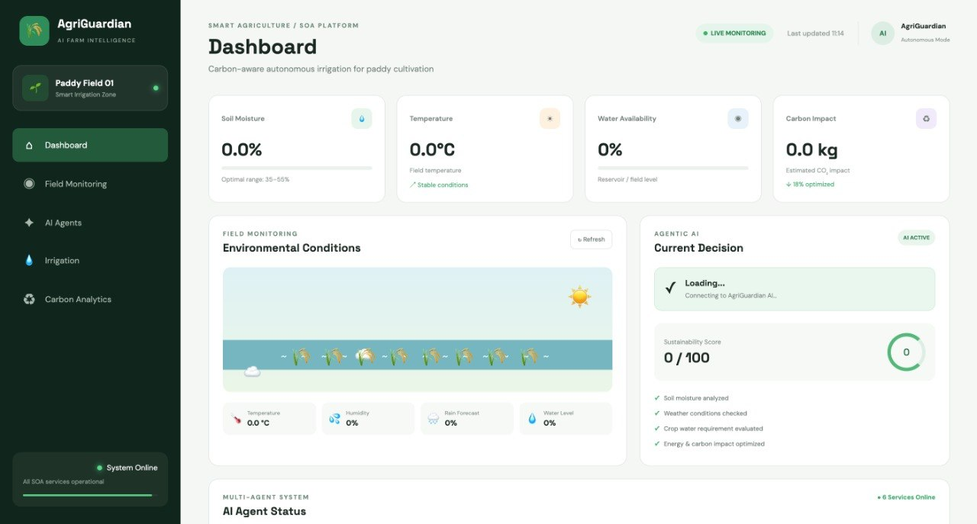
IMPLEMENTATION

Slide 13
